Slide 1
Cryptography and Network Security
Authentication Applications

Slide 2
Authentication Applications
will consider authentication functions
developed to support application-level authentication & digital signatures
will consider Kerberos – a private-key authentication service
then X.509 - a public-key directory authentication service
Notes:
This chapter examines some of the authentication functions that have been developed to support application-level authentication and digital signatures.
Will first look at one of the earliest and most widely used services: Kerberos. Then examine the X.509 directory authentication service.

Slide 3
Kerberos
trusted key server system from MIT
provides centralised private-key third-party authentication in a distributed network
allows users access to services distributed through network
without needing to trust all workstations
rather all trust a central authentication server
two versions in use: 4 & 5
Notes:
Kerberos is an authentication service developed as part of Project Athena at MIT, and is one of the best known and most widely implemented trusted third party key distribution systems.
Kerberos provides a centralized authentication server whose function is to authenticate users to servers and servers to users. Unlike most other authentication schemes, Kerberos relies exclusively on symmetric encryption, making no use of public-key encryption. Two versions of Kerberos are in common use: v4 & v5.

Slide 4
Kerberos Requirements
its first report identified requirements as:
secure
reliable
transparent
scalable
implemented using an authentication protocol based on Needham-Schroeder
Notes:
The first published report on Kerberos [STEI88] listed the requirements shown above. To support these requirements, Kerberos is a trusted third-party authentication service that uses a protocol based on that proposed by Needham and Schroeder [NEED78], which was discussed in Chapter 7.

Slide 5
Kerberos v4 Overview
a basic third-party authentication scheme
have an Authentication Server (AS)
users initially negotiate with AS to identify self
AS provides a non-corruptible authentication credential (ticket granting ticket TGT)
have a Ticket Granting server (TGS)
users subsequently request access to other services from TGS on basis of users TGT
Notes:
The core of Kerberos is the Authentication and Ticket Granting Servers – these are trusted by all users and servers and must be securely administered. The protocol includes a sequence of interactions between the client, AS, TGT and desired server.

Slide 6
Kerberos v4 Dialogue
obtain ticket granting ticket from AS
once per session
obtain service granting ticket from TGT
for each distinct service required
client/server exchange to obtain service
on every service request
Notes:
The full Kerberos v4 authentication dialogue is shown in Stallings Table 14.1, divided into the 3 phases shown above. The justification for each item in the messages is given in Stallings Table 14.2.

Slide 7
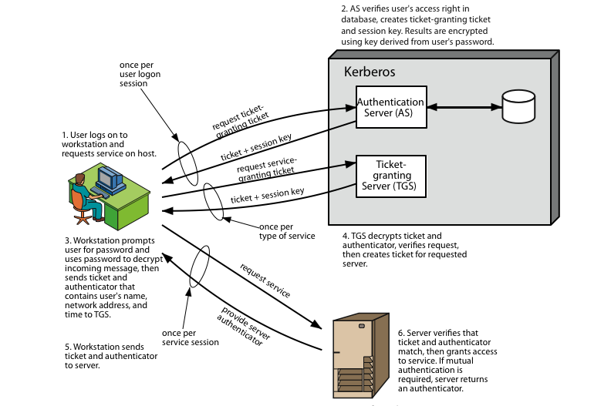
Kerberos 4 Overview
Notes:
Stallings Figure 14.1 diagrammatically summarizes the Kerberos v4 authentication dialogue, with 3 pairs of messages, for each phase listed previously.

Slide 8
Kerberos Realms
a Kerberos environment consists of:
a Kerberos server
a number of clients, all registered with server
application servers, sharing keys with server
this is termed a realm
typically a single administrative domain
if have multiple realms, their Kerberos servers must share keys and trust
Notes:
A full-service Kerberos environment consisting of a Kerberos server, a number of clients, and a number of application servers is referred to as a Kerberos realm. A Kerberos realm is a set of managed nodes that share the same Kerberos database, and are part of the same administrative domain. If have multiple realms, their Kerberos servers must share keys and trust each other.

Slide 9
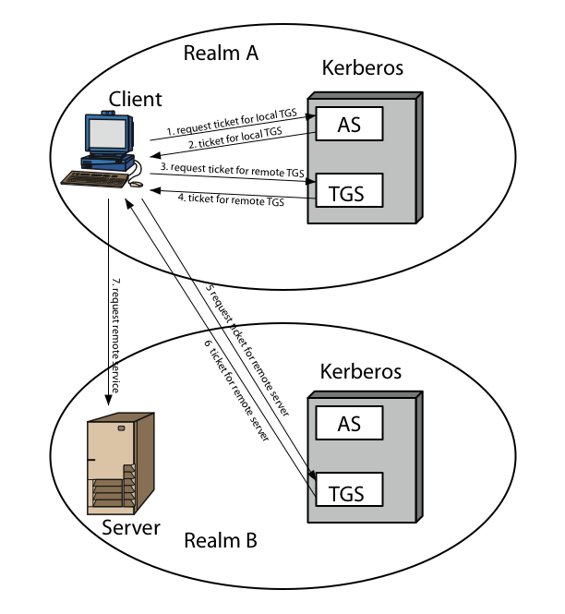
Kerberos Realms
Notes:
Stallings Figure 14.2 shows the authentication messages where service is being requested from another domain. The ticket presented to the remote server indicates the realm in which the user was originally authenticated. The server chooses whether to honor the remote request. One problem presented by the foregoing approach is that it does not scale well to many realms, as each pair of realms need to share a key.

Slide 10
Kerberos Version 5
developed in mid 1990’s
specified as Internet standard RFC 1510
provides improvements over v4
addresses environmental shortcomings
encryption alg, network protocol, byte order, ticket lifetime, authentication forwarding, interrealm auth
and technical deficiencies
double encryption, non-std mode of use, session keys, password attacks
Notes:
Kerberos Version 5 is specified in RFC 1510 and provides a number of improvements over version 4 in the areas of environmental shortcomings and technical deficiencies, in areas as noted. See Stallings Table 14.3 for details of the Kerberos v5 authentication dialogue.

Slide 11
X.509 Authentication Service
part of CCITT X.500 directory service standards
distributed servers maintaining user info database
defines framework for authentication services
directory may store public-key certificates
with public key of user signed by certification authority
also defines authentication protocols
uses public-key crypto & digital signatures
algorithms not standardised, but RSA recommended
X.509 certificates are widely used
Notes:
X.509 is part of the X.500 series of recommendations that define a directory service, being a server or distributed set of servers that maintains a database of information about users.
X.509 defines a framework for the provision of authentication services by the X.500 directory to its users. The directory may serve as a repository of public-key certificates. In addition, X.509 defines alternative authentication protocols based on the use of public-key certificates. X.509 is based on the use of public-key cryptography and digital signatures. The standard does not dictate the use of a specific algorithm but recommends RSA.
The X.509 certificate format is widely used, in for example S/MIME, IP Security and SSL/TLS and SET.

Slide 12
X.509 Certificates
issued by a Certification Authority (CA), containing:
version (1, 2, or 3)
serial number (unique within CA) identifying certificate
signature algorithm identifier
issuer X.500 name (CA)
period of validity (from - to dates)
subject X.500 name (name of owner)
subject public-key info (algorithm, parameters, key)
issuer unique identifier (v2+)
subject unique identifier (v2+)
extension fields (v3)
signature (of hash of all fields in certificate)
notation CA<<A>> denotes certificate for A signed by CA
Notes:
The X.509 certificate is the heart of the standard. There are 3 versions, with successively more info in the certificate - must be v2 if either unique identifier field exists, must be v3 if any extensions are used. These user certificates are assumed to be created by some trusted certification authority (CA) and placed in the directory by the CA or by the user. The directory server itself is not responsible for the creation of public keys or for the certification function; it merely provides an easily accessible location for users to obtain certificates. The certificate includes the elements shown.
The standard uses the notation for a certificate of: CA<<A>> where the CA signs the certificate for user A with its private key.

Slide 13
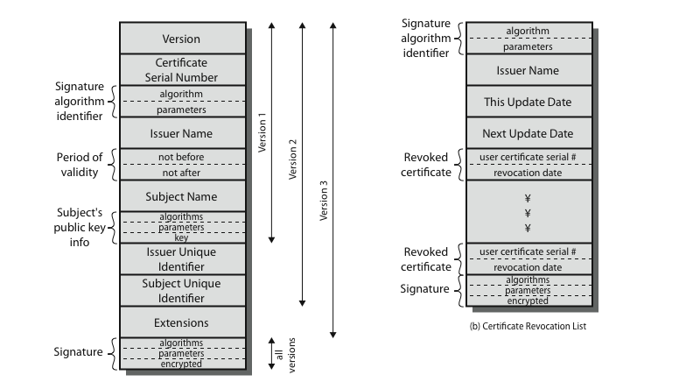
X.509 Certificates
Notes:
Stallings Figure 14.4 shows the format of an X.509 certificate and CRL.

Slide 14
Obtaining a Certificate
any user with access to CA can get any certificate from it
only the CA can modify a certificate
because cannot be forged, certificates can be placed in a public directory
Notes:
User certificates generated by a CA have the characteristics that any user with access to the public key of the CA can verify the user public key that was certified, and no party other than the certification authority can modify the certificate without this being detected. Because certificates are unforgeable, they can be placed in a directory without the need for the directory to make special efforts to protect them.

Slide 15
CA Hierarchy
if both users share a common CA then they are assumed to know its public key
otherwise CA's must form a hierarchy
use certificates linking members of hierarchy to validate other CA's
each CA has certificates for clients (forward) and parent (backward)
each client trusts parents certificates
enable verification of any certificate from one CA by users of all other CAs in hierarchy
Notes:
If both parties use the same CA, they know its public key and can verify others certificates. If not, then there has to be some means to form a chain of certifications between the CA's used by the two parties, by the use of client and parent certificates. It is assumed that each client trusts its parents certificates.

Slide 16
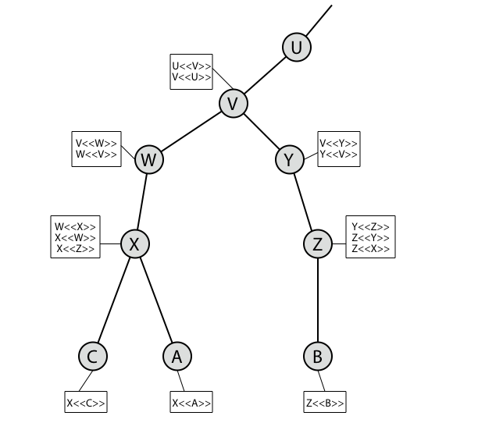
CA Hierarchy Use
Notes:
Stallings Figure 14.5 illustrates the use of an X.509 hierarchy to mutually verify clients certificates.
Track chains of certificates:
A acquires B certificate using chain: X<<W>>W<<V>>V<<Y>>Y<<Z>>Z<<B>>
B acquires A certificate using chain: Z<<Y>>Y<<V>>V<<W>>W<<X>>X<<A>>

Slide 17
Certificate Revocation
certificates have a period of validity
may need to revoke before expiry, eg:
user's private key is compromised
user is no longer certified by this CA
CA's certificate is compromised
CA’s maintain list of revoked certificates
the Certificate Revocation List (CRL)
users should check certificates with CA’s CRL
Notes:
A certificate includes a period of validity. Typically a new certificate is issued just before the expiration of the old one.
In addition, it may be desirable on occasion to revoke a certificate before it expires, for one of a range of reasons, such as those shown above.
To support this, each CA must maintain a list consisting of all revoked but not expired certificates issued by that CA, known as the certificate revocation list (CRL).
When a user receives a certificate in a message, the user must determine whether the certificate has been revoked, by checking the directory CRL each time a certificate is received, this often does not happen in practice.

Slide 18
Authentication Procedures
X.509 includes three alternative authentication procedures:
One-Way Authentication
Two-Way Authentication
Three-Way Authentication
all use public-key signatures
Notes:
X.509 also includes three alternative authentication procedures that are intended for use across a variety of applications, used when obtaining and using certificates. 1-way for unidirectional messages (like email), 2-way for interactive sessions when timestamps are used, 3-way for interactive sessions with no need for timestamps (and hence synchronised clocks). See Stallings Figure 14.6 for details of each of these alternatives.

Slide 19
One-Way Authentication
1 message ( A->B) used to establish
the identity of A and that message is from A
message was intended for B
integrity & originality of message
message must include timestamp, nonce, B's identity and is signed by A
may include additional info for B
eg session key
Notes:
One way authentication involves a single transfer of information from one user (A) to another (B), and establishes the details shown above. Note that only the identity of the initiating entity is verified in this process, not that of the responding entity. At a minimum, the message includes a timestamp ,a nonce, and the identity of B and is signed with A’s private key. The message may also include information to be conveyed, such as a session key for B.

Slide 20
Two-Way Authentication
2 messages (A->B, B->A) which also establishes in addition:
the identity of B and that reply is from B
that reply is intended for A
integrity & originality of reply
reply includes original nonce from A, also timestamp and nonce from B
may include additional info for A
Notes:
Two-way authentication thus permits both parties in a communication to verify the identity of the other, thus additionally establishing the above details. The reply message includes the nonce from A, to validate the reply. It also includes a timestamp and nonce generated by B, and possible additional information for A.

Slide 21
Three-Way Authentication
3 messages (A->B, B->A, A->B) which enables above authentication without synchronized clocks
has reply from A back to B containing signed copy of nonce from B
means that timestamps need not be checked or relied upon
Notes:
Three-Way Authentication includes a final message from A to B, which contains a signed copy of the nonce, so that timestamps need not be checked, for use when synchronized clocks are not available.

Slide 22
X.509 Version 3
has been recognised that additional information is needed in a certificate
email/URL, policy details, usage constraints
rather than explicitly naming new fields defined a general extension method
extensions consist of:
extension identifier
criticality indicator
extension value
Notes:
The X.509 version 2 format does not convey all of the information that recent design and implementation experience has shown to be needed. Rather than continue to add fields to a fixed format, standards developers felt that a more flexible approach was needed. X.509 version 3 includes a number of optional extensions that may be added to the version 2 format. Each extension consists of an extension identifier, a criticality indicator, and an extension value. The criticality indicator indicates whether an extension can be safely ignored or not (in which case if unknown the certificate is invalid).

Slide 23
Certificate Extensions
key and policy information
convey info about subject & issuer keys, plus indicators of certificate policy
certificate subject and issuer attributes
support alternative names, in alternative formats for certificate subject and/or issuer
certificate path constraints
allow constraints on use of certificates by other CA’s
Notes:
The certificate extensions fall into three main categories:
key and policy information - convey additional information about the subject and issuer keys, plus indicators of certificate policy
subject and issuer attributes - support alternative names, in alternative formats, for a certificate subject or certificate issuer and can convey additional information about the certificate subject
certification path constraints - allow constraint specifications to be included in certificates issued for CA’s by other CA’s

Slide 24
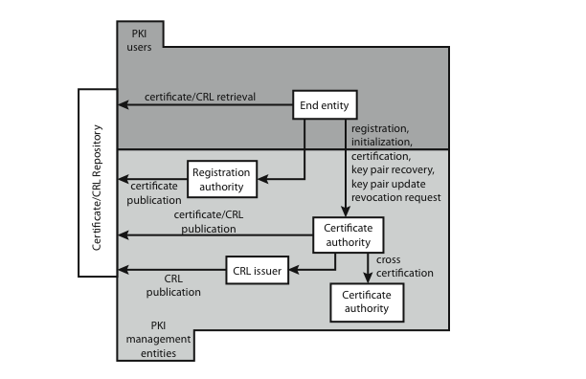
Public Key Infrastructure
Notes:
RFC 2822 (Internet Security Glossary) defines public-key infrastructure (PKI) as the set of hardware, software, people, policies, and procedures needed to create, manage, store, distribute, and revoke digital certificates based on asymmetric cryptography. The IETF Public Key Infrastructure X.509 (PKIX) working group has setup a formal (and generic) model based on X.509 that is suitable for deploying a certificate-based architecture on the Internet.
Stallings Figure 14.7 shows the interrelationship among the key elements of the PKIX model, and lists the various management functions needed.

Slide 25
Electronic Mail Security

Slide 26
Email Security
email is one of the most widely used and regarded network services
currently message contents are not secure
may be inspected either in transit
or by suitably privileged users on destination system
Notes:
In virtually all distributed environments, electronic mail is the most heavily used network-based application. But current email services are roughly like "postcards”, anyone who wants could pick it up and have a look as its in transit or sitting in the recipients mailbox.

Slide 27
Email Security Enhancements
confidentiality
protection from disclosure
authentication
of sender of message
message integrity
protection from modification
non-repudiation of origin
protection from denial by sender
Notes:
With the explosively growing reliance on electronic mail for every conceivable purpose, there grows a demand for authentication and confidentiality services. What we want is something more akin to standard mail (contents protected inside an envelope) if not registered mail (have confidence about the sender of the mail and its contents). That is, the “classic” security services listed are desired.

Slide 28
Pretty Good Privacy (PGP)
widely used de facto secure email
developed by Phil Zimmermann
selected best available crypto algs to use
integrated into a single program
on Unix, PC, Macintosh and other systems
originally free, now also have commercial versions available
Notes:
The Pretty Good Privacy (PGP) secure email program, is a remarkable phenomenon, has grown explosively and is now widely used. Largely the effort of a single person, Phil Zimmermann, who selected the best available crypto algorithms to use & integrated them into a single program, PGP provides a confidentiality and authentication service that can be used for electronic mail and file storage applications. It runs on a wide range of systems, in both free & commercial versions.

Slide 29
PGP Operation – Authentication
sender creates message
use SHA-1 to generate 160-bit hash of message
signed hash with RSA using sender's private key, and is attached to message
receiver uses RSA with sender's public key to decrypt and recover hash code
receiver verifies received message using hash of it and compares with decrypted hash code
Notes:
The actual operation of PGP consists of five services: authentication, confidentiality, compression, e-mail compatibility, and segmentation.
Here see the digital signature service provided by PGP, using the steps as shown. Note this assumes use of RSA digital signatures, recent PGP versions also support the use of DSS signatures. Signatures can also be detached from a message/file and sent/stored separately.

Slide 30
PGP Operation – Confidentiality
sender generates message and 128-bit random number as session key for it
encrypt message using CAST-128 / IDEA / 3DES in CBC mode with session key
session key encrypted using RSA with recipient's public key, & attached to msg
receiver uses RSA with private key to decrypt and recover session key
session key is used to decrypt message
Notes:
Another basic service provided by PGP is confidentiality, provided by encrypting messages to be transmitted or to be stored locally as files, using symmetric encryption algorithms CAST-128, IDEA or 3DES in 64-bit cipher feedback (CFB) mode. The randomly chosen session key used for this is sent encrypted using the recipient’s public RSA key. The steps used in this process are as shown. Recent PGP versions also support the use of ElGamal (a Diffie-Hellman variant) for session-key exchange.

Slide 31
PGP Operation – Confidentiality & Authentication
can use both services on same message
create signature & attach to message
encrypt both message & signature
attach RSA/ElGamal encrypted session key
Notes:
Both confidentiality & authentication services may be used for the same message. Firstly a signature is generated for the plaintext message and prepended to the it. Then the plaintext message plus signature is encrypted using CAST-128 (or IDEA or 3DES), and the session key is encrypted using RSA (or ElGamal).

Slide 32
PGP Operation – Compression
by default PGP compresses message after signing but before encrypting
so can store uncompressed message & signature for later verification
& because compression is non deterministic
uses ZIP compression algorithm
Notes:
By default PGP compresses the message after applying the signature but before encryption. This has the benefit of saving space both for e-mail transmission and for file storage. The signature is generated before compression for the reasons shown. The compression algorithm used is ZIP, which is described in Stallings Appendix 15A.

Slide 33
PGP Operation – Email Compatibility
when using PGP will have binary data to send (encrypted message etc)
however email was designed only for text
hence PGP must encode raw binary data into printable ASCII characters
uses radix-64 algorithm
maps 3 bytes to 4 printable chars
also appends a CRC
PGP also segments messages if too big
Notes:
When PGP is used, at least part of the block to be transmitted is encrypted, and thus consists of a stream of arbitrary 8-bit octets. However many electronic mail systems only permit the use of ASCII text. To accommodate this restriction, PGP provides the service of converting the raw 8-bit binary stream to a stream of printable ASCII characters. It uses radix-64 conversion, in which each group of three octets of binary data is mapped into four ASCII characters. This format also appends a CRC to detect transmission errors. See Stallings Appendix 15B for a description.
PGP also automatically subdivides a message that is too large for a single email, into segments that are small enough to send.

Slide 34
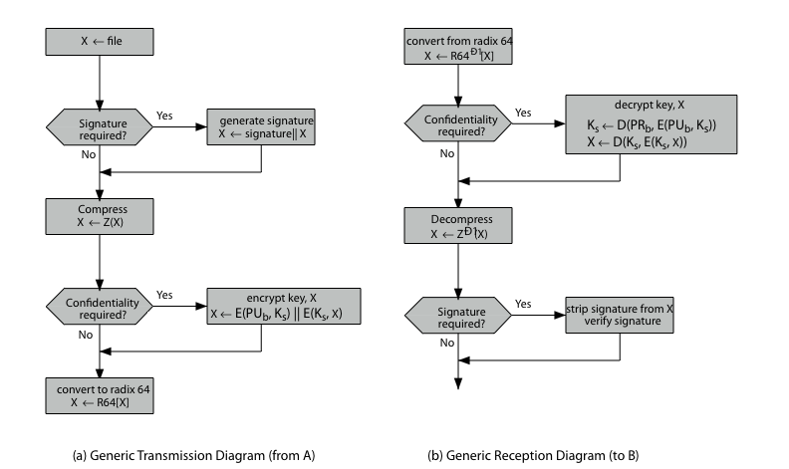
PGP Operation – Summary
Notes:
Stallings Figure 15.2 illustrates the general operation of PGP, and the relationship between the services discussed.

Slide 35
PGP Session Keys
need a session key for each message
of varying sizes: 56-bit DES, 128-bit CAST or IDEA, 168-bit Triple-DES
generated using ANSI X12.17 mode
uses random inputs taken from previous uses and from keystroke timing of user
Notes:
PGP makes use of four types of keys: one-time session symmetric keys, public keys, private keys, and passphrase-based symmetric keys.
Each session key is associated with a single message and is used only for the purpose of encrypting and decrypting that message. Random numbers are generated using the ANSI X12.17 generator, with inputs based on keystroke input from the user, where both the keystroke timing and the actual keys struck are used to generate a randomized stream of numbers. Stallings Appendix 15C discusses PGP random number generation techniques in more detail.

Slide 36
PGP Public & Private Keys
since many public/private keys may be in use, need to identify which is actually used to encrypt session key in a message
could send full public-key with every message
but this is inefficient
rather use a key identifier based on key
is least significant 64-bits of the key
will very likely be unique
also use key ID in signatures
Notes:
Since many public/private keys may be in use with PGP, there is a need to identify which key is actually used to encrypt the session key for any specific message. You could just send the full public-key with every message, but this is inefficient. Rather PGP use a key identifier based on the least significant 64-bits of the key, which will very likely be unique. Then only the much shorter key ID would need to be transmitted with any message. A key ID is also required for the PGP digital signature.

Slide 37
S/MIME (Secure/Multipurpose Internet Mail Extensions)
security enhancement to MIME email
original Internet RFC822 email was text only
MIME provided support for varying content types and multi-part messages
with encoding of binary data to textual form
S/MIME added security enhancements
have S/MIME support in many mail agents
eg MS Outlook, Mozilla, Mac Mail etc
Notes:
S/MIME (Secure/Multipurpose Internet Mail Extension) is a security enhancement to the MIME Internet e-mail format standard, which in turn provided support for varying content types and multi-part messages over the text only support in the original Internet RFC822 email standard. MIME allows encoding of binary data to textual form for transport over traditional RFC822 email systems. S/MIME support is now included in many modern mail agents.

Slide 38
S/MIME Functions
enveloped data
encrypted content and associated keys
signed data
encoded message + signed digest
clear-signed data
cleartext message + encoded signed digest
signed & enveloped data
nesting of signed & encrypted entities
Notes:
In terms of general functionality, S/MIME is very similar to PGP. Both offer the ability to sign and/or encrypt messages. S/MIME provides the functions shown.

Slide 39
S/MIME Cryptographic Algorithms
digital signatures: DSS & RSA
hash functions: SHA-1 & MD5
session key encryption: ElGamal & RSA
message encryption: AES, Triple-DES, RC2/40 and others
MAC: HMAC with SHA-1
have process to decide which algs to use
Notes:
S/MIME uses a range of cryptographic algorithms, as shown.
The S/MIME specification includes a discussion of the procedure for deciding which content encryption algorithm to use, based on the capabilities of all parties.

Slide 40
S/MIME Messages
S/MIME secures a MIME entity with a signature, encryption, or both
forming a MIME wrapped PKCS object
have a range of content-types:
enveloped data
signed data
clear-signed data
registration request
certificate only message
Notes:
S/MIME secures a MIME entity with a signature, encryption, or both. A MIME entity may be an entire message or one or more of the subparts of the message. The MIME entity plus some security related data, such as algorithm identifiers and certificates, are processed by S/MIME to produce a PKCS, which refers to a set of public-key cryptography specifications issued by RSA Laboratories. A PKCS object is then treated as message content and wrapped in MIME. Have a range of S/MIME content-types, as shown.

Slide 41
S/MIME Certificate Processing
S/MIME uses X.509 v3 certificates
managed using a hybrid of a strict X.509 CA hierarchy & PGP’s web of trust
each client has a list of trusted CA’s certs
and own public/private key pairs & certs
certificates must be signed by trusted CA’s
Notes:
S/MIME uses public-key certificates that conform to version 3 of X.509 (see Chapter 14). The key-management scheme used by S/MIME is in some ways a hybrid between a strict X.509 certification hierarchy and PGP’s web of trust. S/MIME managers and/or users must configure each client with a list of trusted keys and with certificate revocation lists, needed to verify incoming signatures and to encrypt outgoing messages. But certificates are signed by trusted certification authorities.

